Slide 1
Internet Monitoring for NPS in Canada
January 2019
Office of Drug Research and Surveillance
Controlled Substances Directorate
Health Canada

Slide 2
Outline
Background of the project
Previous search methods and results
Additional online resources
Psychoactive plants, extracts, seeds, and spores
Challenges with previous search methods
What is the dark web?
What is scraping?
What are we doing?

Slide 3
Background on Internet monitoring for NPS
One of the common places that NPS are sold is via the internet. Starting in November 2012 we began systematically searching the Internet for Canadian websites that are selling New Psychoactive Substances (NPS).
Our goal was to determine if we could identify websites operating in Canada that were selling NPS and to identify which substances were offered for sale.
The protocols used were adapted from protocols used by groups in Europe that had been successful in identifying numerous NPS websites worldwide (e.g., Psychonaut Web Mapping Project and the EMCDDA Snapshots).

Slide 4


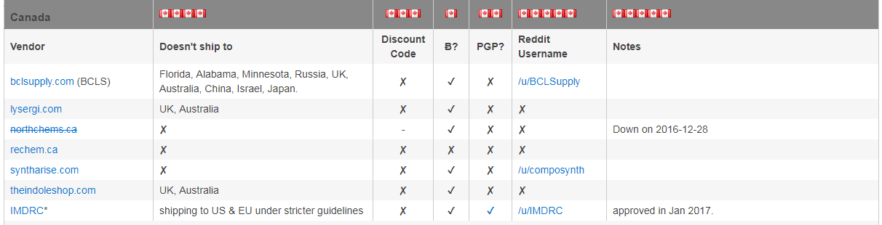
Previous search methods
5 search strings are entered into 3 popular search engines (Yahoo®, Bing®, & Google®).
5 Search Strings:
Research Chemicals Canada
Legal Highs Canada
Herbal Highs Canada
Buy __________ Canada
__________ Canada
Note: In search strings 4 & 5 the blanks represent specific substance names that are relevant at the time of the search.
The first 10 pages of results are manually searched for relevant results.
Searches are also done on open drug discussion forums that allow discussion of sources (e.g. reddit).
These searches look for the keyword “Canad*”.
Notes:
There was an RCSources reddit that has now been closed.

Slide 5



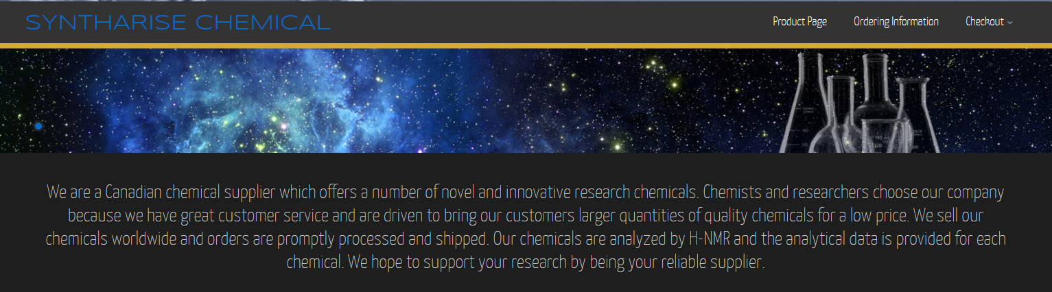

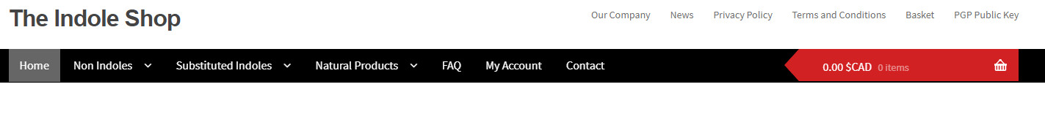
Canadian websites selling mostly legal NPS
Information retrieved March 6, 2018
www.bclsupply.com
www.rechem.ca
www.syntharise.com
www.lysergi.com
www.theindoleshop.com
www.imdrc.com (members only)

Slide 6



Use of drug discussion forums for additional information
There are several open drug discussion forums (e.g., bluelight.org, drugs-forum.com, erowid.org). These forums do not allow discussion about sources but are still valuable resources for information on, and user’s experiences with NPS.
These forums are searched on an ad-hoc basis to gather information about particular NPS.
Ad-hoc searches can also be performed to identify emerging NPS or to determine which NPS are generating the most discussion.

Slide 7
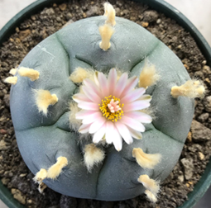
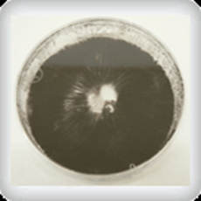
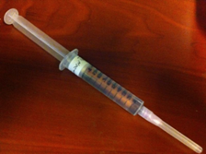
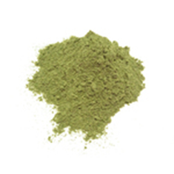
Websites legally selling psychoactive plants, extracts, seeds, and spores
Peyote cactus (Lophophora williamsii)
www.magicactus.com
Mushroom spores (Psilocybe cubensis)
www.vancouverseedbank.ca
Kratom (Mitragyna speciosa)
www.canadakratomexpress.com

Slide 8
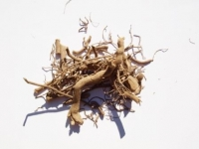
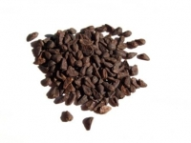
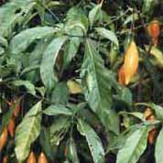
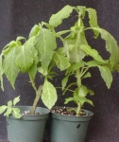
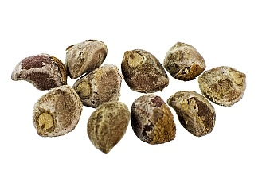
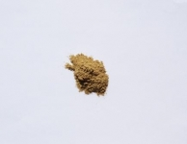
Finding Canadian websites
Locating websites is not difficult. Simple Google® searches such as “Canadian ethnobotanicals” and “Canadian kratom” return numerous results.
Other Google® searches for specific ethnobotanicals also return a large number of results.
There is limited time to search all the results. Generally we would only search for Canadian websites selling these products when a specific request is made.
Kava Kava (Piper methysticum) Whole Root
Iboga (Tabernathe iboga) Root Bark
Morning Glory (Ipomoea tricolor) Seeds
Kanna (Sceletium tortuosum) Powder
Salvia divinorum Plants
Hawaiian Baby Woodrose (Argyreia nervosa) Seeds

Slide 9
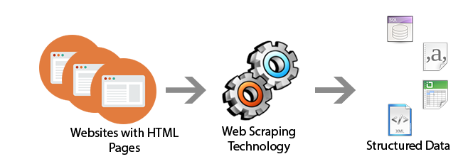

Challenges with previous methods
Challenges:
All searches were done manually by one person which limits the number of results that can be checked for relevance.
Only websites that appear to be operating from Canada are recorded. There are many international websites that will ship substances to Canada but there are not enough resources to track these websites.
An unknown number of sellers use invite-only websites and some intentionally try to avoid being identify by the popular search engines.
In the past, access to Tor-based websites (dark web) was limited so the extent and types of NPS available is unknown. For NPS that are controlled under the CDSA the use of dark web allows sellers and buyers great anonymity.
Moving forward:
Automation of searches using tools such as web scrapers.
Access to Tor-based websites/markets (dark web).

Slide 10
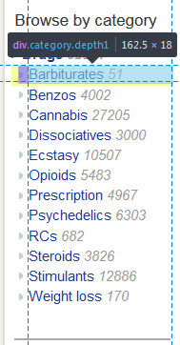
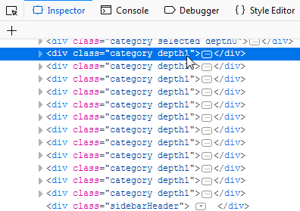
Scraping
The general concept of scraping is to look at the HTML code of the web page and look for patterns in the way the data is stored.
In the example below, you can see that each of the category links is held in a div class named “category depth1”. This can be used to loop through each of these specific sections.

Slide 11
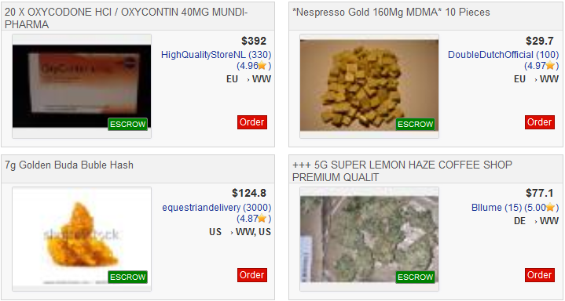
Creating a database from a dark web market pages
Any dark web market will have a database of their listings. There is no way to access the source database, but it can be reverse-engineered.
Listing title | Price | Seller | Ships from | Ships to
20 X OXYCODONE HCI / OXYCONTIN 40MG MUNDI-PHARMA | $392 | A | EU | WW
*Nespresso Gold 160Mg MDMA* 10 Pieces | $29.70 | B | EU | WW
7g Golden Buda Buble Hash | $124.80 | C | US | WW, US
+++ 5G SUPER LEMON HAZE COFFEE SHOP PREMIUM QUALIT | $77.1 | D | DE | WW
Notes:
Basically, the people running Dream Market create the website by saying “for each row in our database of listings, create a little box. The listing title variable goes here at the top, the price goes here, etc”. They just need to ‘design’ one box, and then they can loop through their database with the same logic for all 80,000 listings.
To re-create the database from the web page, I just create a process that loops through each box in the page, and creates a new row in my database where the title field gets its data from the appropriate HTML field, same for the price and so on. Just like them, I just need to write out the logic for one box, and then loop through the rest of them.

Slide 12
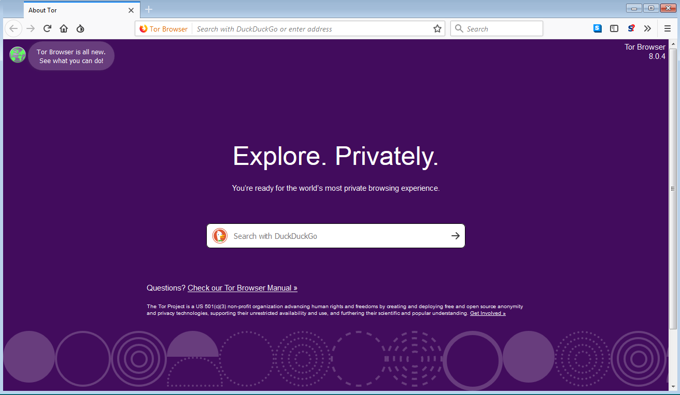
The dark web - Tor
The dark web is a portion of the internet that requires specific software (i.e. Tor) to access.
Tor routes the data coming to and from the user through several relays, which are run by the community.
Otherwise, it functions as a normal browser.

Slide 13
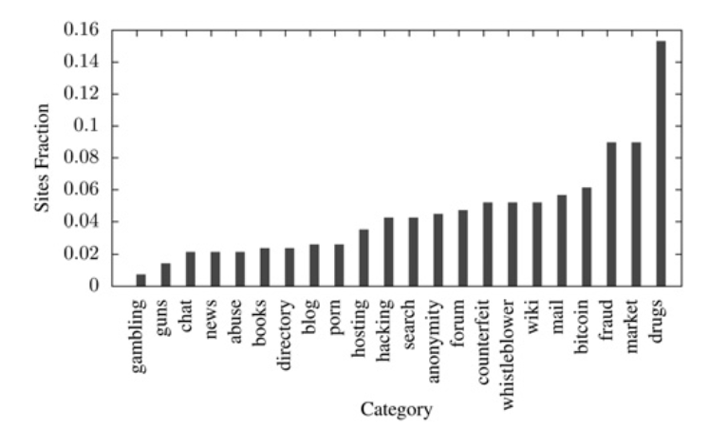
Breakdown of Tor sites
Owen, G., & Savage, N. (2016). Empirical analysis of Tor Hidden Services. IET Information Security, 10(3), 113–118. https://doi.org/10.1049/iet-ifs.2015.0121

Slide 14
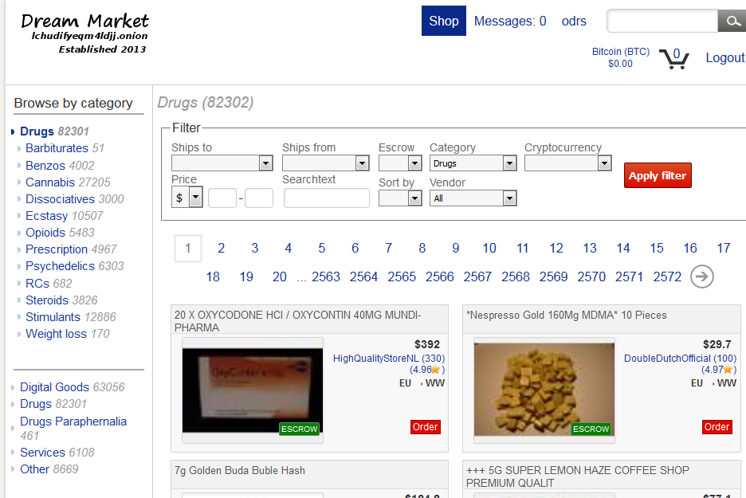
Drugs on the dark web
Notes:
As the previous slide showed, drugs are the largest category on the dark web. This is the Dream Market, the largest operating market on the dark web. The website operates as a host for users to sell drugs from consumer to consumer. Anyone can make a listing or purchase. Although they sell other things, drugs are their largest category with over 80,000 listings. For our purposes, they are essentially the ebay of drugs.

Slide 15
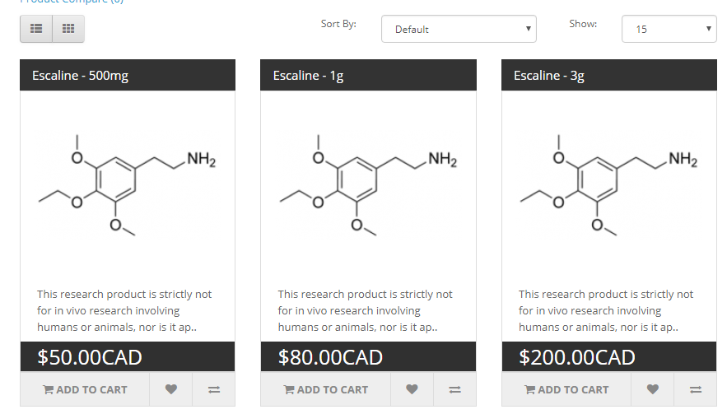
Open web research chemical example
As opposed to ebay-style consumer-to-consumer markets found on the dark web, open web drug sellers sell direct to consumer by selling legal drugs that have a psychoactive effect.
Notes:
As opposed to ebay-style consumer-to-consumer markets that are found on the dark web, what we find on the open web are business-to-consumer models. This makes it much easier to scrape the data, as it means that there will be one listing per drug, as opposed to thousands of listings just for different people selling meth.
Scraping the open web is essentially the same process. So far, ReChem has been scraped, as I’ve seen it as the most commonly mentioned supplier on research chemical discussion forums.

Slide 16
Future plans
The next step will be to thoroughly map out the websites we are interested in scraping and begin expanding our data sources.
A single database with cleaned data from several markets (dark web and legal) provide valuable and convenient information that has previously been obfuscated.
Additionally, creating better scrapers that can function more reliably will allow for them to be run on an automated interval. This will add a time component to the data and allow us to track trends (prices, drug availability) over time.
There is also the possibility to scrape larger amounts of data from user discussion forums and analyse/categorize it using natural language processing.

Slide 17
Limitations
You can’t get sales data, which means you can find the average list price, but not the average sale price.
If you have 5 listings of meth ranging from $7-11 per gram, you can say that the average sale price is $9. However, since you don’t know how many sales were made on each of the listings, you can’t say what the actual average sale price of meth is.
Maintenance cost. It is feasible to scrape the data of each drug market website, but creating and maintaining code to scrape them continually over time is much more difficult. Any changes in website schema must be reflected in the scraper.

